Slide 1
Characterization of analogue ASIC for L1 Trigger Decision. CTA.
Automatic Test Data
Description.
Fit Rate Scan
Fit Offset
- Characterization
- Correlations
Gain
- Characterization
- Correlations.
Difference Analog and Fit Offset.
Characterization
Correlations.
Correlation Analysis
Noise
Characterization
Bad Points
Conclusions
Open Questions
Aim: Global characterization of L1 Trigger decision ASICs.
Data source: Individual measures of all the ASICs tested in the Quality Control.
Results:
  - Global knowledge of behaviour of the ASICs (Offset, Gain and Noise).
      - A criteria for detecting possible defective ASICs.

Slide 2
Automatic Test Data
Automatic Test Data
Description.
Fit Rate Scan
Fit Offset
- Characterization
- Correlations
Gain
- Characterization
- Correlations.
Difference Analog and Fit Offset.
Characterization
Correlations.
Correlation Analysis
Noise
Characterization
Bad Points
Conclusions
Open Questions
Quality Control Test 390 ASICS for characterization of Noise, Gain and Offset.
383: OK. 2: Fail test. 5: Need to repeat analog offset test.
Test DAC
- Max. and Min. voltage in DAC.
Test Analog Offset
- Direct measure of analog offset.
- 7 Channels.
- 3 Adders.
Test Voltage.
- Input Voltage [mV]: 100-1000 mV.
10 steps 100 mV
- Output Rate Scan [mV]:
7 Channels.
3 Adders.
2 Discriminators.
Test Digital Offset
- Output status as a function of threshold.
- 7 Channels.
- 3 Adders.
- 2 Discriminatos.
- Measures[mV]:
Max Value.
Min Value.
Offset.
Noise.
Test Adder Channels
- Gain for different channel adds combinations (modes).

Slide 3
Fit Rate Scan
Automatic Test Data
Description.
Fit Rate Scan
Fit Offset
- Characterization
- Correlations
Gain
- Characterization
- Correlations.
Difference Analog and Fit Offset.
Characterization
Correlations.
Correlation Analysis
Noise
Characterization
Bad Points
Conclusions
Open Questions
Fit of Input Voltage vs. Output voltage from Rate Scan.
Linear relation:
Vrs = Gain*Vin + Fit Offset
Fit for different ranges[mV] (ASIC 61):
Linear only for low Vin values.
- Difference Analog Offset(AO) – Fit Offset(FO) increases with range.
Best range: 0-300 mV, minimun difference AO – FO.
- Some points depending on Adder and/or channel behave different.
0-300 | 0-400 | 0-500 | 0-600 | 0-700
0-900 | 200-400 | 200-500 | 200-600 | 300-700

Slide 4
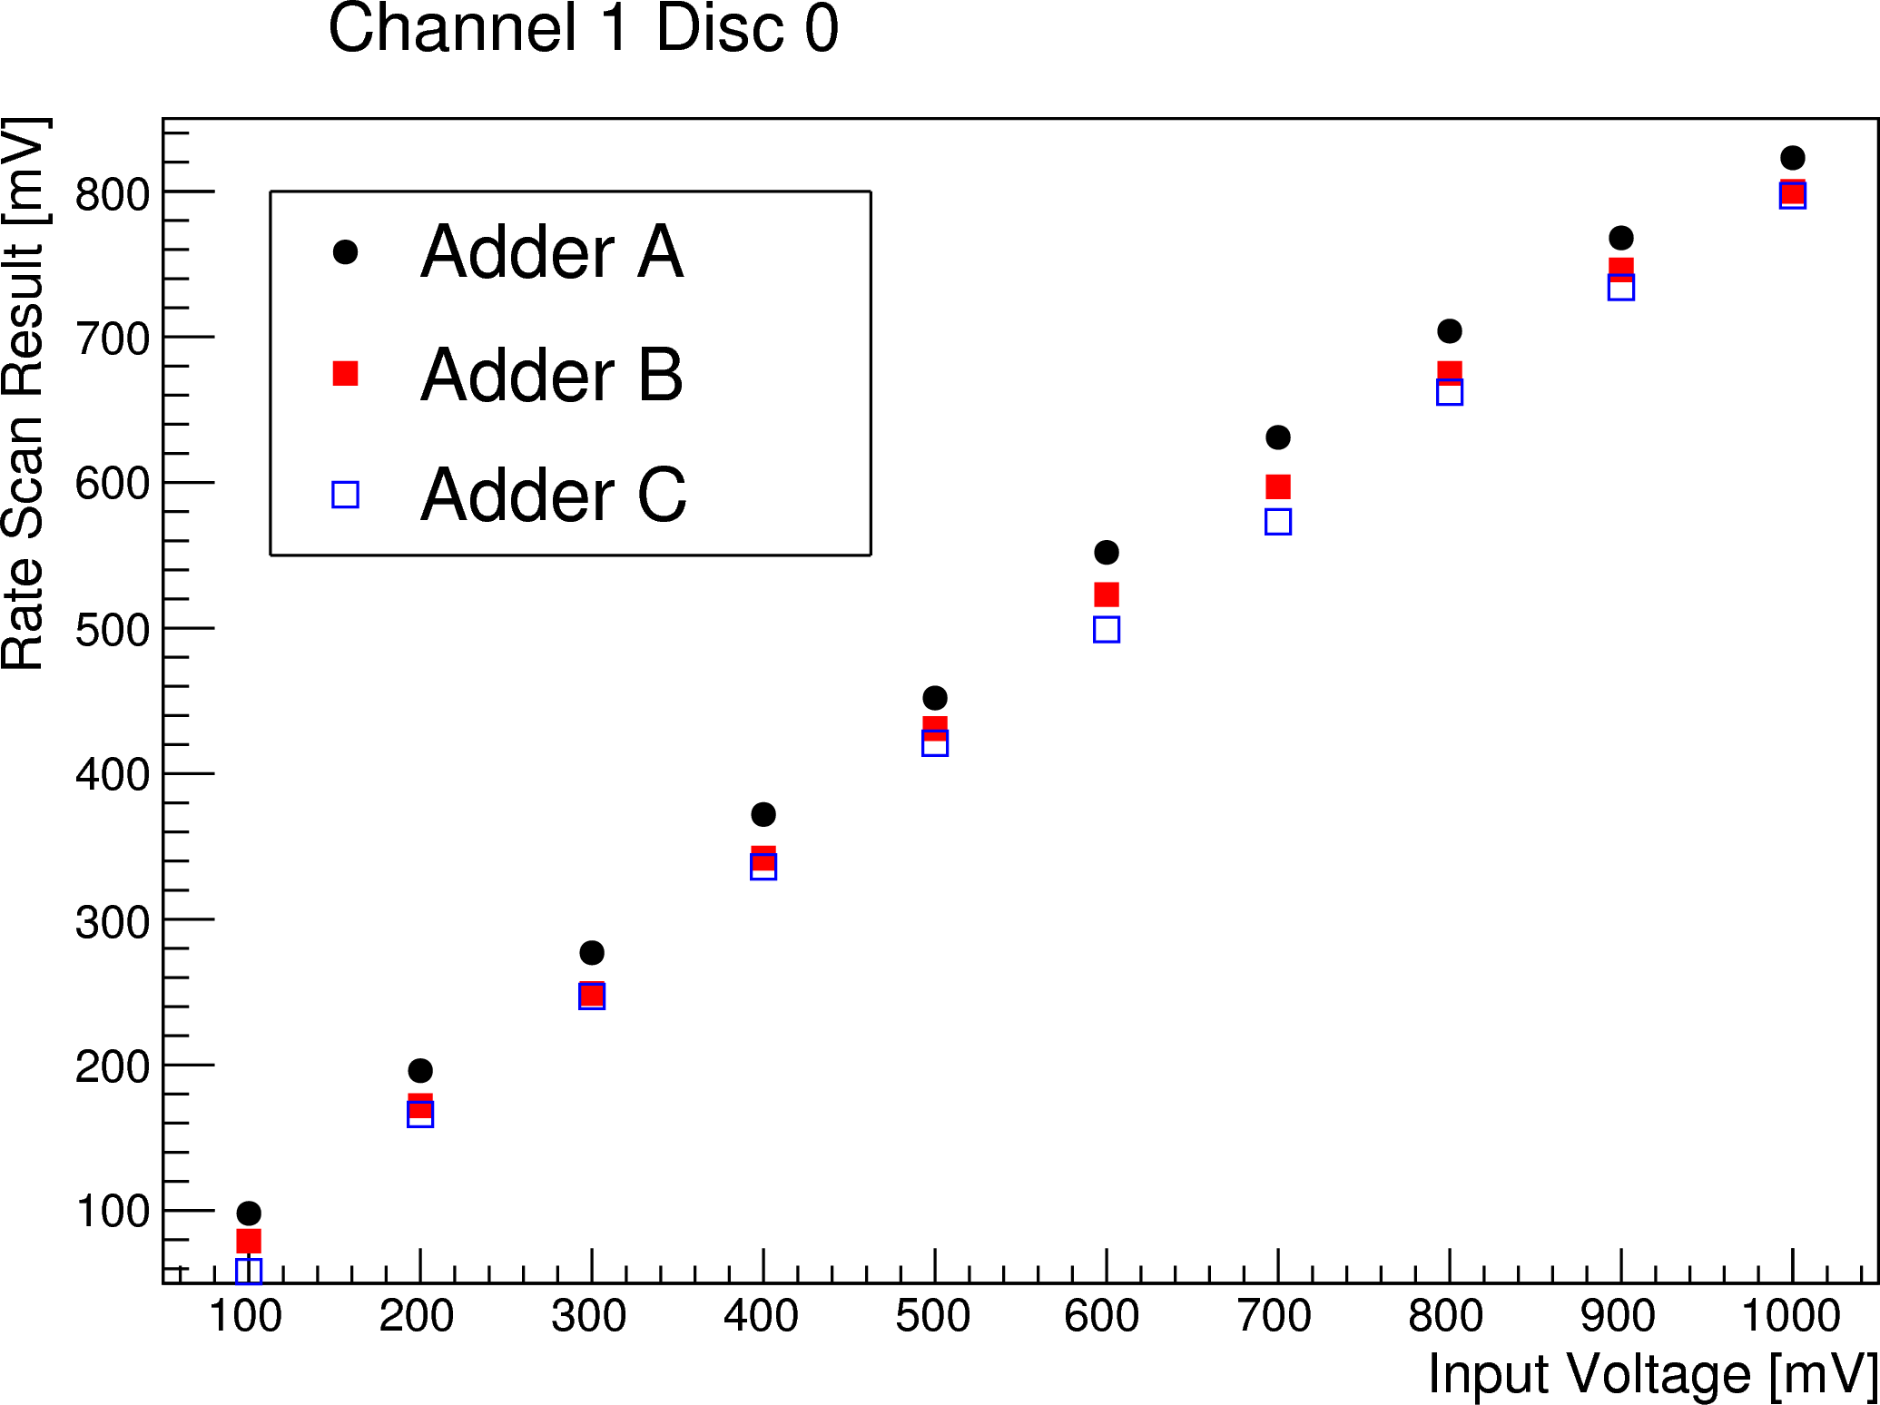
Fit Rate Scan
Automatic Test Data
Description.
Fit Rate Scan
Fit Offset
- Characterization
- Correlations
Gain
- Characterization
- Correlations.
Difference Analog and Fit Offset.
Characterization
Correlations.
Correlation Analysis
Noise
Characterization
Bad Points
Conclusions
Open Questions
Figure 1: Rate Scan Result vs Input Voltage for Channel 1 and Discriminator 0 in ASIC#61. Plots for all channels of the 383 analyzed ASICS are similar. Linear fit in the range 0 – 300 mV was made to calculate the Fit Offset and Gain of each ASIC.

Slide 5
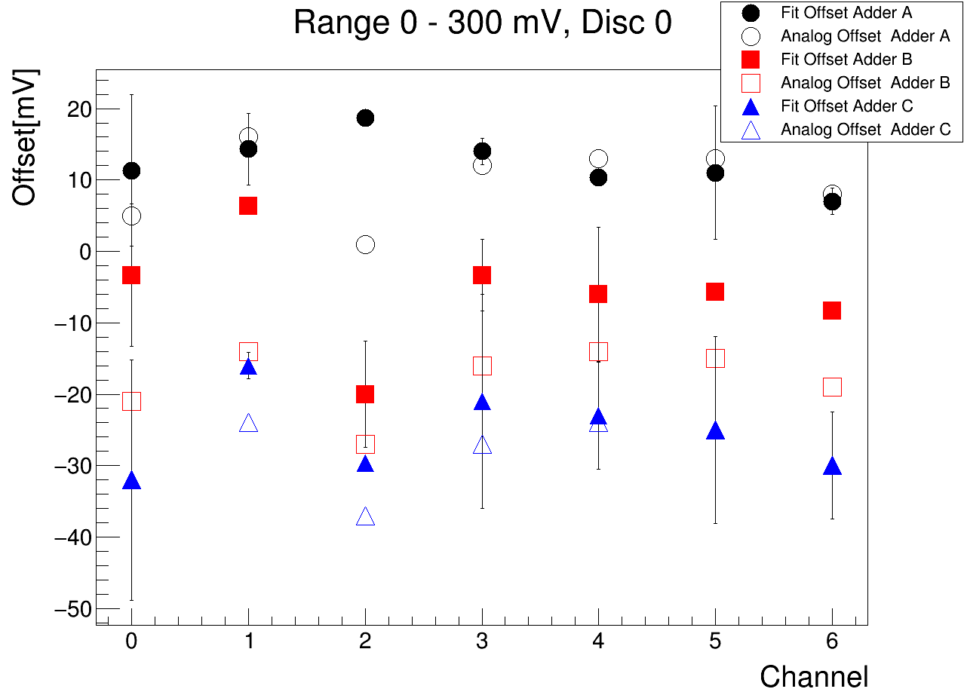
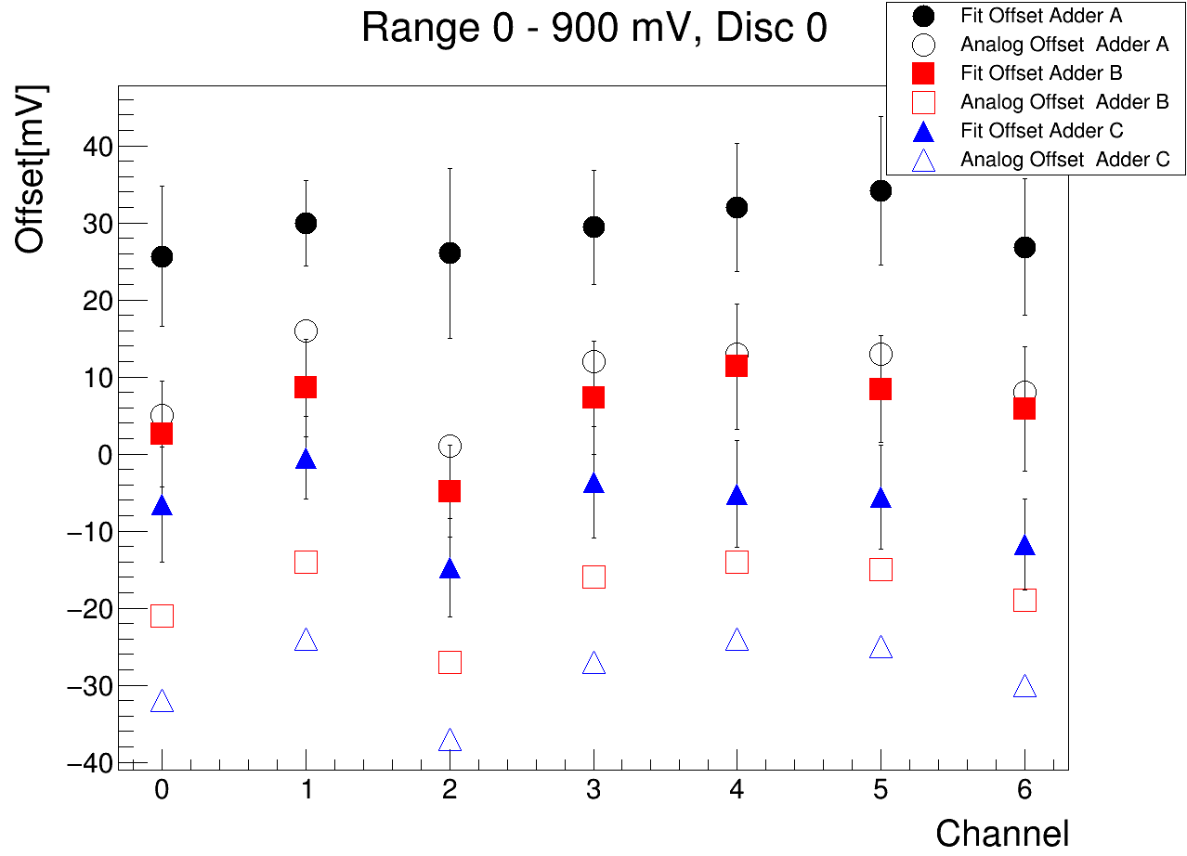
Fit Rate Scan
Automatic Test Data
Description.
Fit Rate Scan
Fit Offset
- Characterization
- Correlations
Gain
- Characterization
- Correlations.
Difference Analog and Fit Offset.
Characterization
Correlations.
Correlation Analysis
Noise
Characterization
Bad Points
Conclusions
Open Questions
Figure 2: Fit Offset (filled markers) and Analog Offset was plotted for every adder, channel and discriminator. It can be appreciated that, in general, the difference between AO and FO increases with range due to the no linearity at high voltages. Some points specially in adder B present some discrepancies which has to be studied.

Slide 6
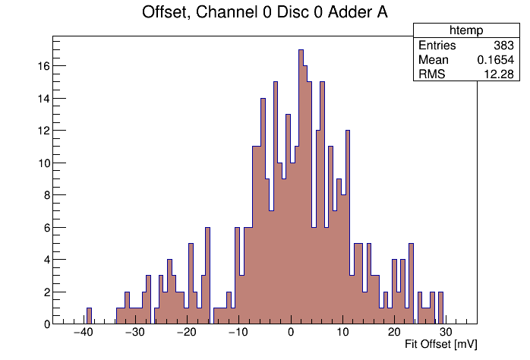
Fit Rate Scan
Fit Offset: Characterization
Automatic Test Data
Description.
Fit Rate Scan
Fit Offset
- Characterization
- Correlations
Gain
- Characterization
- Correlations.
Difference Analog and Fit Offset.
Characterization
Correlations.
Correlation Analysis
Noise
Characterization
Bad Points
Conclusions
Open Questions
Linear fit of Rate Scan result for 383 ASICs in the range of 0 – 300 mV. Calculation of Fit Offset and Gain.
Figure 3: Fit Offset distribution for two combinations of Channel, Adder and Discriminator calculated for all Asics. Plots for all combinations of channel-adder-disc have been made.

Slide 7
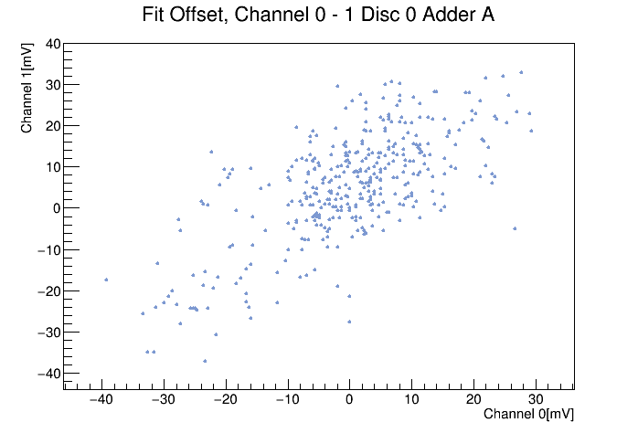
Fit Rate Scan
Fit Offset: Correlations.
Automatic Test Data
Description.
Fit Rate Scan
Fit Offset
- Characterization
- Correlations
Gain
- Characterization
- Correlations.
Difference Analog and Fit Offset.
Characterization
Correlations.
Correlation Analysis
Noise
Characterization
Bad Points
Conclusions
Open Questions
Correlations between offsets from different channels for all asics has been plotted to check if every channel behaves in a consistent way.
Figure 4: Correlation between channels of the Fit Offset for fixed Adder and Discriminator. Plots for all combinations of two channels for fixed Adder-Discriminator has been made. It can be observed that there is a linear correlation within ASICs, when offset increases in one channel it increases also in the others.

Slide 8
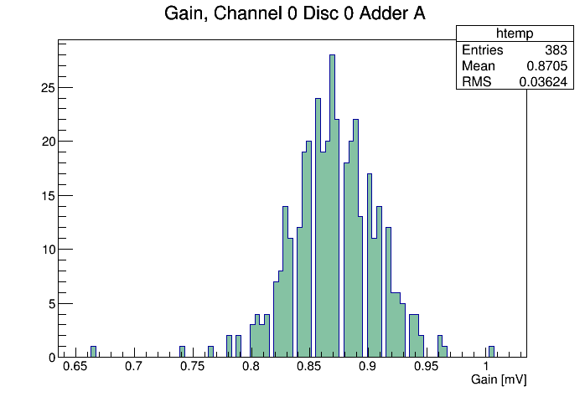
Fit Rate Scan
Gain: Characterization
Automatic Test Data
Description.
Fit Rate Scan
Fit Offset
- Characterization
- Correlations
Gain
- Characterization
- Correlations.
Difference Analog and Fit Offset.
Characterization
Correlations.
Correlation Analysis
Noise
Characterization
Bad Points
Conclusions
Open Questions
Linear fit of Rate Scan result for 383 ASICs in the range of 0 – 300 mV. Calculation of Fit Offset and Gain.
Figure 5: Distribution of gain calculated by fit, for all tested ASICs. Similar histograms for every combination of channel, discriminator and adder were made. It can be observed that, in general, gain is centered in a value around 0,87+- 0,036 mV.

Slide 9
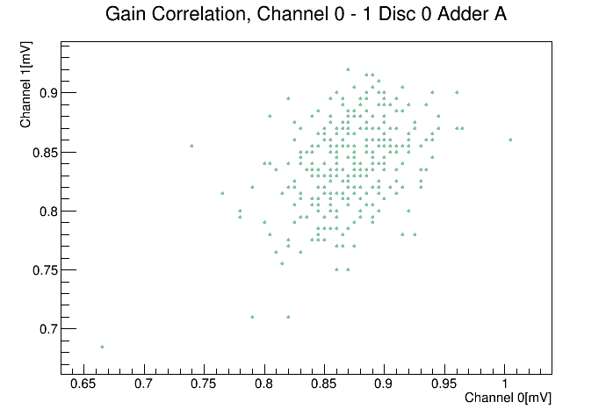
Fit Rate Scan
Gain: Correlations.
Automatic Test Data
Description.
Fit Rate Scan
Fit Offset
- Characterization
- Correlations
Gain
- Characterization
- Correlations.
Difference Analog and Fit Offset.
Characterization
Correlations.
Correlation Analysis
Noise
Characterization
Bad Points
Conclusions
Open Questions
Correlations between gains from different channels for all asics has been plotted to check if every channel behaves in a consistent way.
Figure 6: Correlation between channels of the Gain for fixed adder and discriminator. Similar plots were made for every two channel combination.
Correlation is not as clear as in the offset plots but in general, an ASIC with low gain in one channel has low gain also in all the others.

Slide 10
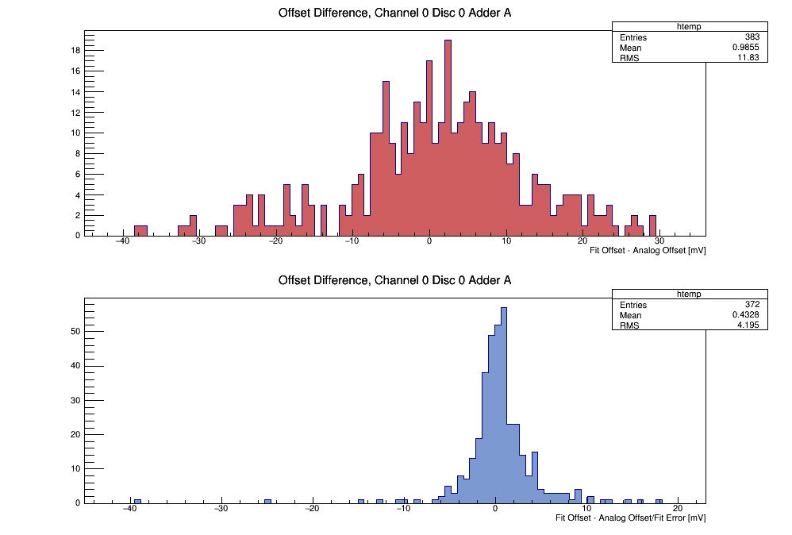
Difference Analog and Fit Offset
Characterization.
Automatic Test Data
Description.
Fit Rate Scan
Fit Offset
- Characterization
- Correlations
Gain
- Characterization
- Correlations.
Difference Analog and Fit Offset.
Characterization
Correlations.
Correlation Analysis
Noise
Characterization
Bad Points
Conclusions
Open Questions
Difference between the Fit Offset calculated and the Analog Offset measured has been computed for all channels, adders and discriminators from all ASICs with aim of evaluating the rate scan method to calculate the offset.
Difference FO-AO divided by FO error has been also presented in order to evaluate the influence of those errors.
Figure 7a: Distribution of the Offset differences, FO – AO (Top) and FO – AO/ Fit Error(Bottom). Similar histograms were made for all channels, adders and discriminator.

Slide 11
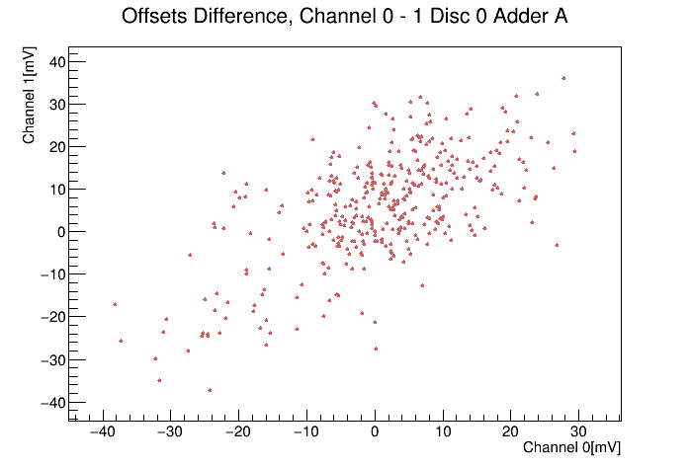
Difference Analog and Fit Offset
Correlations.
Automatic Test Data
Description.
Fit Rate Scan
Fit Offset
- Characterization
- Correlations
Gain
- Characterization
- Correlations.
Difference Analog and Fit Offset.
Characterization
Correlations.
Correlation Analysis
Noise
Characterization
Bad Points
Conclusions
Open Questions
Correlations between FO - AO for different channels from all ASICs has been plotted to check if every channel behaves in a consistent way.
Figure 8: Correlation between channels of the FO – AO for fixed adder and discriminator. Similar plots have been made for every two channels combination. A linear correlation is observed, similar to the one for the Fit Offset.

Slide 12
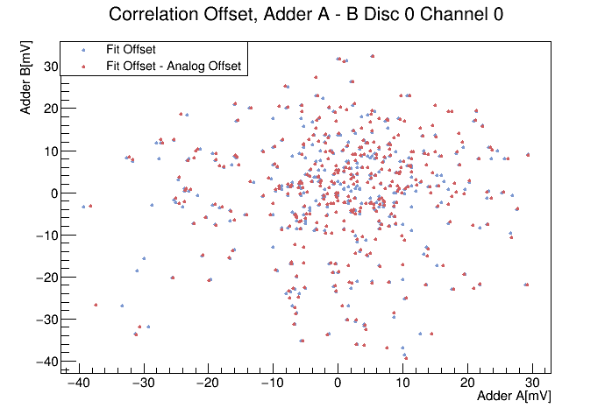
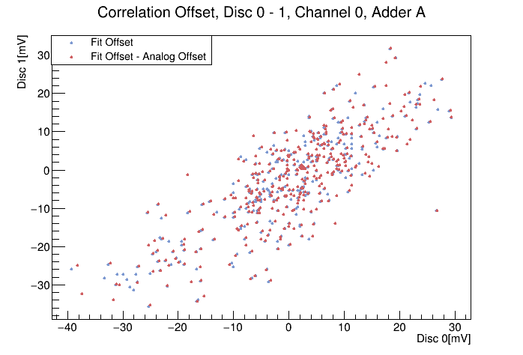
Correlations Analysis
Automatic Test Data
Description.
Fit Rate Scan
Fit Offset
- Characterization
- Correlations
Gain
- Characterization
- Correlations.
Difference Analog and Fit Offset.
Characterization
Correlations.
Correlation Analysis
Noise
Characterization
Bad Points
Conclusions
Open Questions
Its has been observed a clear correlation between channels for the fit offset and the offset difference FO-AO. We must study if the adder and/or the discriminator are resposible of the common behaviour.
Figure 9: Correlation between adders for fixed channel-discriminator (left) and between discriminators for fixed channel-adder(right). It can be observed that there is a correlation between discriminators but not between adders.

Slide 13
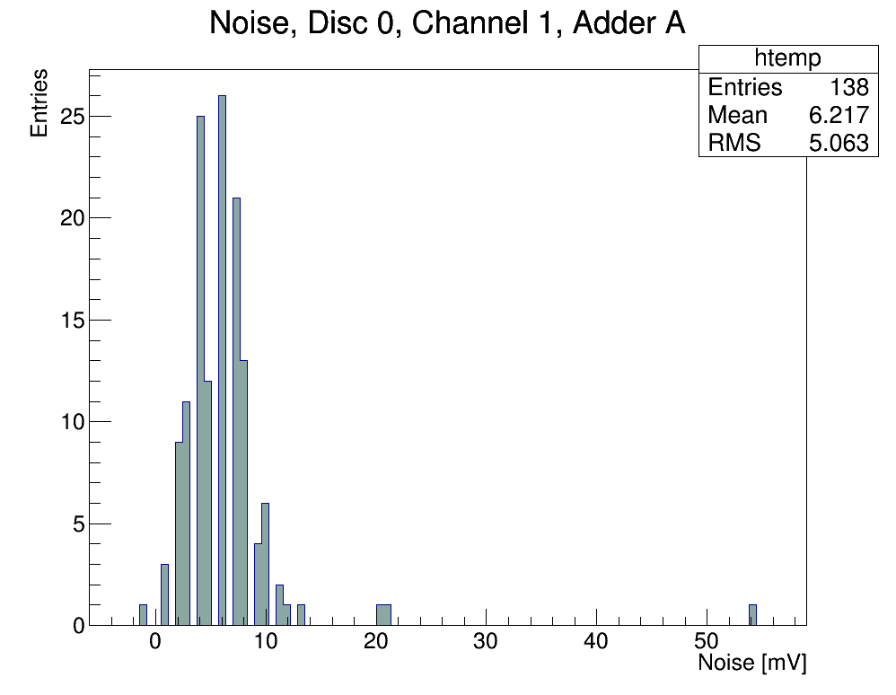
Noise
Characterization.
Automatic Test Data
Description.
Fit Rate Scan
Fit Offset
- Characterization
- Correlations
Gain
- Characterization
- Correlations.
Difference Analog and Fit Offset.
Characterization
Correlations.
Correlation Analysis
Noise
Characterization
Bad Points
Conclusions
Open Questions
Noise has been calculated during the Automatic Test, in the Digital Offset Test. With the methodology used only when the output is always a logic 1 it is possible to calculate the Noise, therefore it has been possible to calculate it only for certain adders in each ASIC.
Figure 10: Noise[mV] distribution calculated for a combination of discriminator, channel and adder. Similar histograms were made for all different combinations.

Slide 14
Bad Points
Automatic Test Data
Description.
Fit Rate Scan
Fit Offset
- Characterization
- Correlations
Gain
- Characterization
- Correlations.
Difference Analog and Fit Offset.
Characterization
Correlations.
Correlation Analysis
Noise
Characterization
Bad Points
Conclusions
Open Questions
During the data analysis, it has been detected remarkable deviations from the typical values of gain and offset calculated in the fit, for several ASICs which need to be reviewed.
        Measures for those ASICs might need to be repeated.
        Defective ASIC detection criteria.
_________________________________________________________________
#Asic Disc Channel Adder FO AO Diff Gain
____________________________________________________________________________
197 0 3 0 -62.6667 0 -62.6667 0.615
197 0 3 1 -63.6667 -0.1 -63.5667 0.605
197 0 3 2 1649.07 -0.4 1649.47 -5.874
197 0 4 0 1593.27 0 1593.27 -4.986
197 1 3 0 -64.6667 0 -64.6667 0.605
197 1 3 1 -58.6667 -0.1 -58.5667 0.58
197 1 3 2 -67.6667 -0.4 -67.2667 0.57
197 1 4 1 47.6667 -0.1 47.7667 0.825
____________________________________________________________________________
209 0 1 1 37.3333 -0.1 37.4333 0.7
209 1 1 0 14.3333 0 14.3333 0.68
209 1 1 1 32.6667 -0.1 32.7667 0.7
____________________________________________________________________________
268 1 1 2 49 0 49 0.79
268 1 5 2 48 -0.1 48.1 0.8
____________________________________________________________________________
329 0 0 0 29 -0.3 29.3 0.665
329 0 1 0 23 0 23 0.685
329 0 1 1 -9.66667 -0.1 -9.56667 0.7
329 0 1 2 23 -0.1 23.1 0.645
329 0 2 0 31 0.4 30.6 0.66
329 0 5 1 3 1.8 1.2 0.7
329 0 6 2 21 0.1 20.9 0.695
329 1 3 0 30.3333 -0.1 30.4333 0.7
329 1 5 1 16 1.8 14.2 0.675
_______________________________________________________
Exclusion cirteria:
Gain < 0,7 mV
Fit Offset < -55 mV
Fit Offset > 45 mV
**ASIC 197 failed the automatic Test
(Test Voltage and
Test Adders) **
Table 1: Values of Gain and Fit Offset considered too deviated from the main values of the rest of ASIC.
Gain < 0,7 mV, Fit Offset < -55 mV, Fit Offset > 45 mV.

Slide 15
Conclusions
Automatic Test Data
Description.
Fit Rate Scan
Fit Offset
- Characterization
- Correlations
Gain
- Characterization
- Correlations.
Difference Analog and Fit Offset.
Characterization
Correlations.
Correlation Analysis
Noise
Characterization
Bad Points
Conclusions
Open Questions
This data analysis has provided useful information for the characterization of the ASICs tested in the Quality Control.
Measuring Offset using the fit:
    The means of the distributions of the offset differences are mainly centered at 0, within the statistical error. Deviations from this behaviour appear for some discriminator-channel-adder combinations with the highest mean being 8,23 for 0-3-2.
    The width of the distribution lays in 11-15 mV, except for 0-3-2 and 0-4-0 with 85,2 and 82,32 respectively.
    This deviations from typical values are produced by ASICs with “bad points”, mainly ASIC 197.
Offset Correlations:
    There is a clear correlation between channels in the offset that goes at the same adder-discriminator.
    There is a clear correlation between the two discriminators.
    There is no correlation between adders.
    Adders are responsible of the offsets.
Gain:
    In general, there is good uniformity in the gain, with values around 0,86 +- 0,04.
    Some values seems to be too low (< 0,7) and this measures should be reviewed,
    Correlation between channels for the gain is not very strong but consistent.

Slide 16
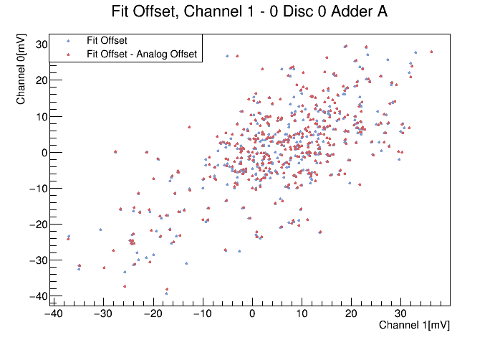
Open Questions
Automatic Test Data
Description.
Fit Rate Scan
Fit Offset
- Characterization
- Correlations
Gain
- Characterization
- Correlations.
Difference Analog and Fit Offset.
Characterization
Correlations.
Correlation Analysis
Noise
Characterization
Bad Points
Conclusions
Open Questions
Why channel-channel correlation for Fit Offset and FO-AO difference has so similar structure?
Review Analog Offset measures, very low values for a big number of ASICs seems to be the problem.
Gain-Channel relation ¿Is there a channel with very low-high gain?
Search for extreme values of gain for certain channels could be a criteria to discard bad ASICs.

